Slide 1

NBA Data Analysis
2012-2024
By: Ashish, Khlood, Shiza, Sirisha

Slide 2

Introduction of dataset
Overview: Performance statistics of NBA players from the 2012-2024 , including regular and playoff season data.
"GP" ="Games Played"
"MIN" ="Minutes Played"
"PTS"="Points"
"FGM"="Field Goals Made"
"FGA"="Field Goals Attempted"
"FG_PCT"="Field Goal Percentage"
"FG3M"="3 Point Field Goals Made"
"FG3A"="3 Point Field Goals Attempted"
"FG3_PCT"="3 Point Field Goal Percentage"
"FTM"="Free Throws Made"
"FTA"="Free Throws Attempted"
"FT_PCT"="Free Throw Percentage"
"OREB"="Offensive Rebounds"
"DREB"="Defensive Rebounds"
"REB"="Rebounds"
"AST"="Assists"
"STL"="Steals"
"BLK" ="Blocks"
"TOV" ="Turnovers"
"PF" ="Personal Fouls"
NBA TEAMS
BKN = Brooklyn Nets
BOS = Boston Celtics
NYK = New York Knicks
PHI = Philadelphia 76ers
TOR = Toronto Raptors
CHI = Chicago Bulls
CLE = Cleveland Cavaliers
DET = Detroit Pistons"
IND = Indiana Pacers
MIL = Milwaukee Bucks
ATL = Atlanta Hawks
CHA = Charlotte Hornets
MIA = Miami Heat
ORL = Orlando Magic
WAS = Washington Wizards
DEN = Denver Nuggets
MIN = Minnesota Timberwolves
OKC = Oklahoma City Thunder
POR = Portland Trail Blazers
UTA = Utah Jazz
GSW = Golden State Warriors
LAC = LA Clippers
LAL = Los Angeles Lakers
PHX = Phoenix Suns
SAC = Sacramento Kings
DAL = Dallas Mavericks
HOU = Houston Rockets
MEM = Memphis Grizzlies
NOP = New Orleans Pelicans
SAS = San Antonio Spurs
NOH = New Orleans Hornets

Slide 3
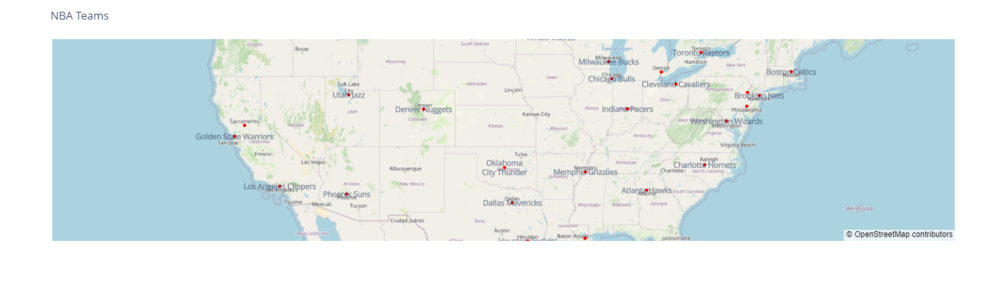
Map of NBA TEAMS

Slide 4
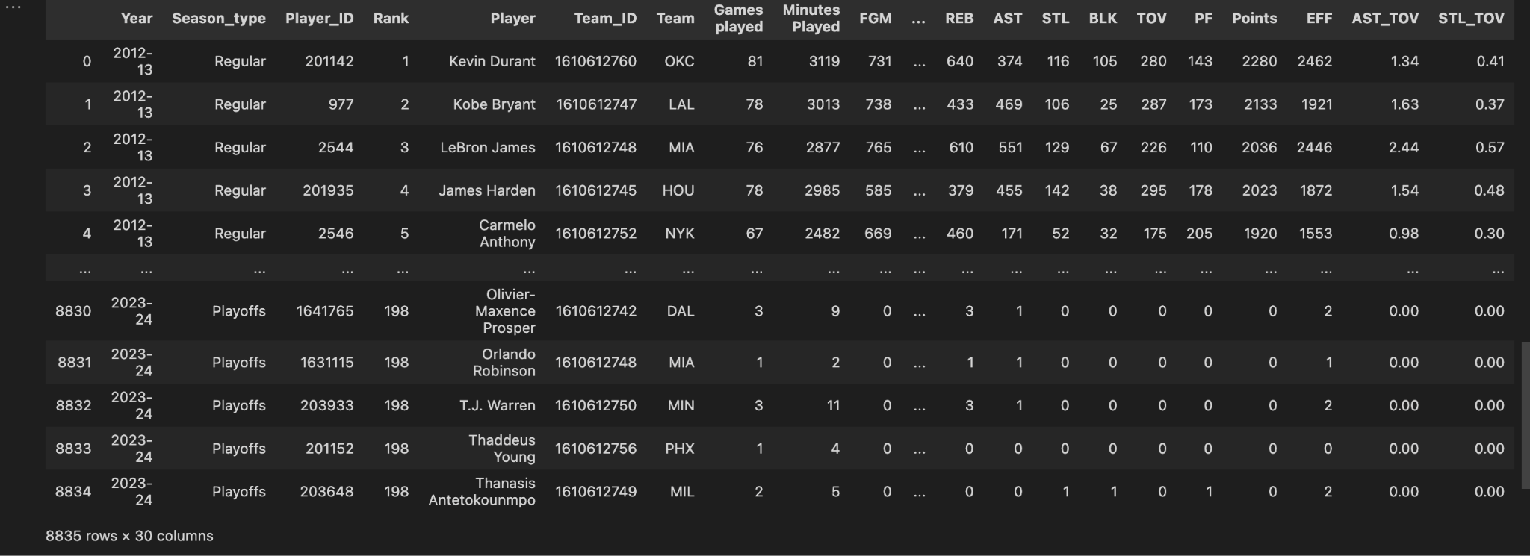
NBA Dataset

Slide 5
Key Features and Questions
Key Features:
Performance Metrics: Points, Assists, Field goals attempted, Rebounds, Steals, Blocks, Efficiency.
Comprehensive Coverage: Data from every player active in the season, offering a complete view of the league.
Up-to-Date Information: Reflects the most recent stats, making it a valuable resource for current analysis.
Questions:
Q1: What is the difference in performance of the top 5 players in regular and playoff seasons?
Q2: Is there a correlation between the Efficiency of a player and points scored.
Q3: Top players with the highest points per minute scored?
Q4: Comparisons between teams and their points scored in both seasons?
Q5: How 3 pointers in both seasons changed the scoring trends of NBA over years 2012-2024?

Slide 6
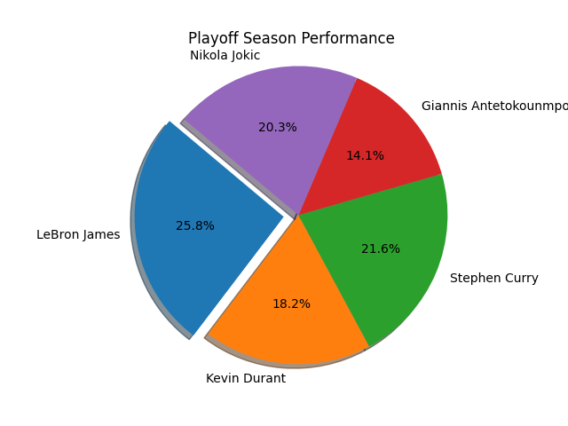
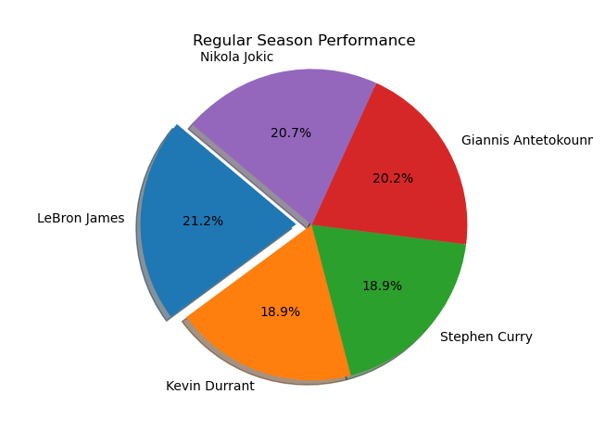
What is the difference in performance of the top 5 players in regular and playoff seasons?
LeBron James maintains a strong presence, but the competition tightens with other players, particularly Kevin Durant and Giannis Antetokounmpo, showing significant contribution
LeBron James leads with 21.2% of the overall performance, closely followed by Nikola Jokic with 20.7%.

Slide 7
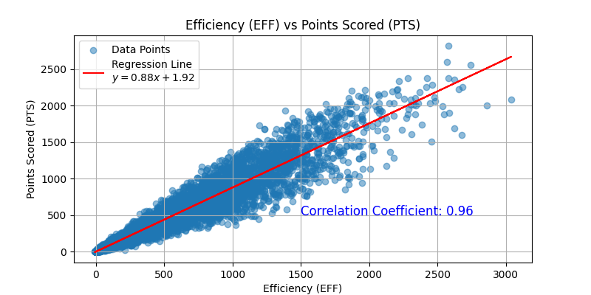
Is there a correlation between the Efficiency of a player and Points Scored?

Slide 8
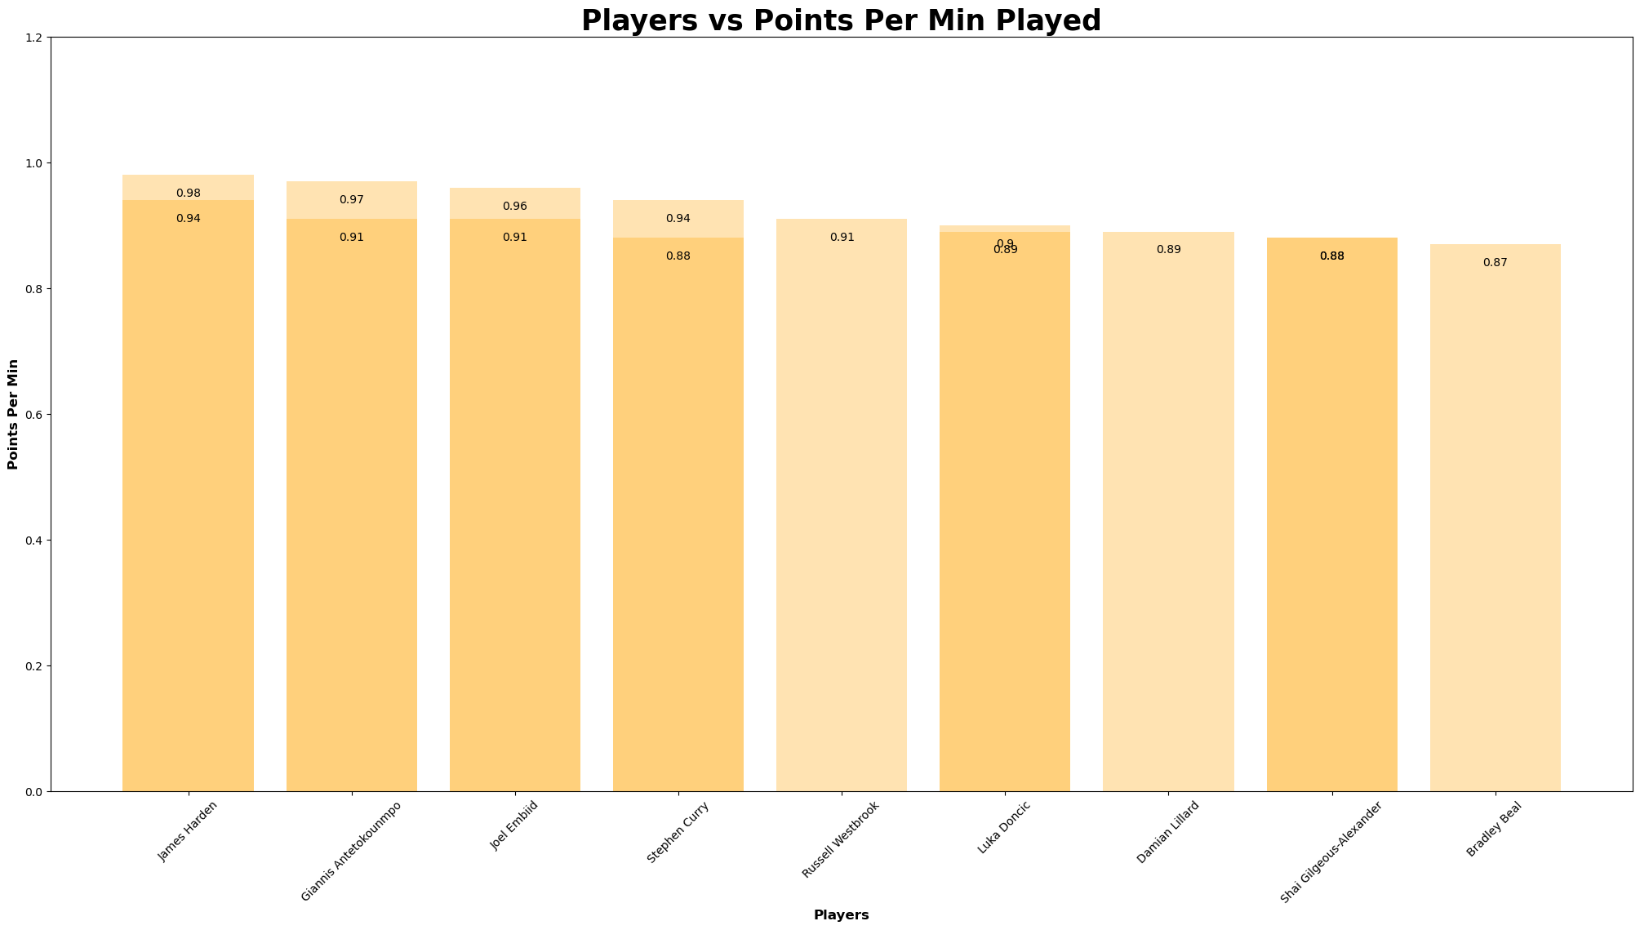
Top players with the highest points per minute scored?
According to the bar graph, it can be seen that James Harden (Houston cougars), has the highest PPM in two seasons; 0.98 (2018-19) and 0.94(2019-20). Followed by Giannis (Milwaukee Bucks), who also has two high scoring seasons on the list; 0.97(2022-23) and 0.91(2021-22). In third place we have Joel Embiid (Philadelphia 76ers) with a high PPM in two seasons; 0.96(2022-23) and 0.91(2021-22).

Slide 9
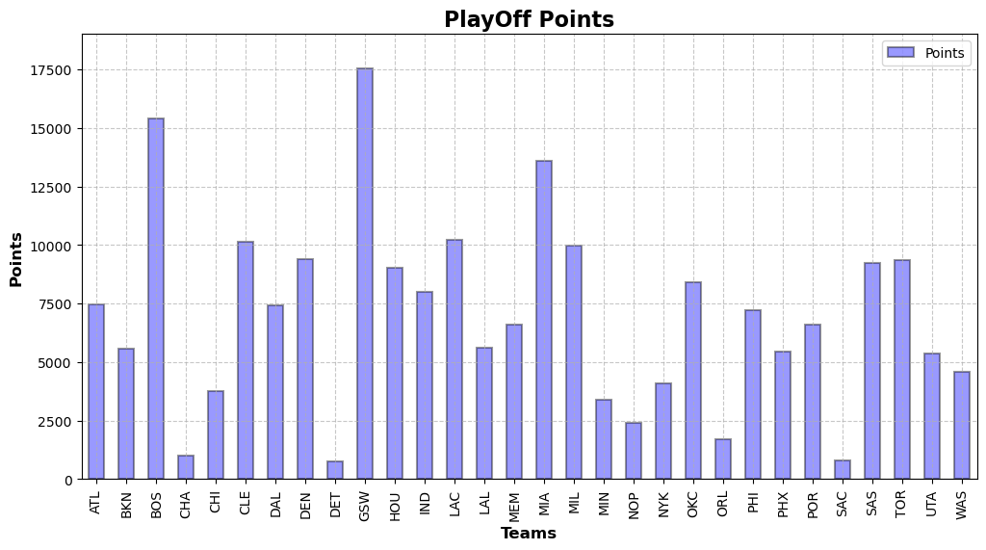
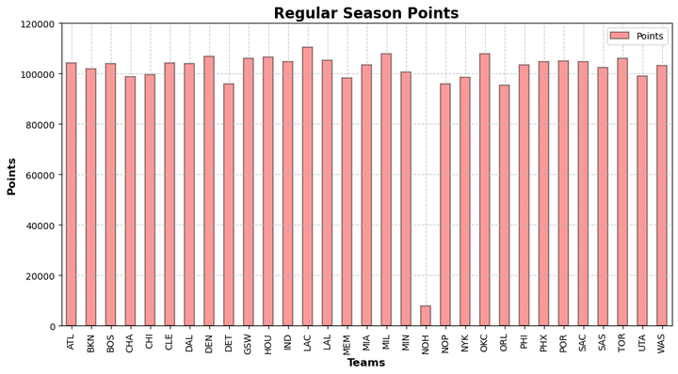
Comparisons between teams and their points scored in both seasons?
In the playoff seasons, it can be seen that the highest scorer with 17500 points in total is Golden State Warriors from San Francisco. In the regular season, The highest being LA Clippers who are very closely followed by Milwaukee Bucks and in third place is the Oklahoma City Thunder.

Slide 10
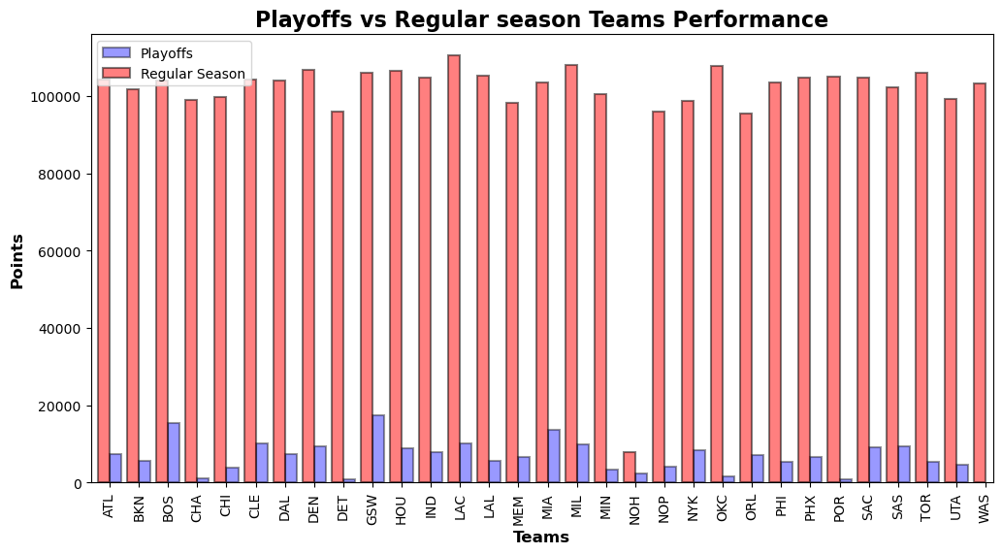
Comparisons between teams and their points scored in both seasons? MERGED

Slide 11
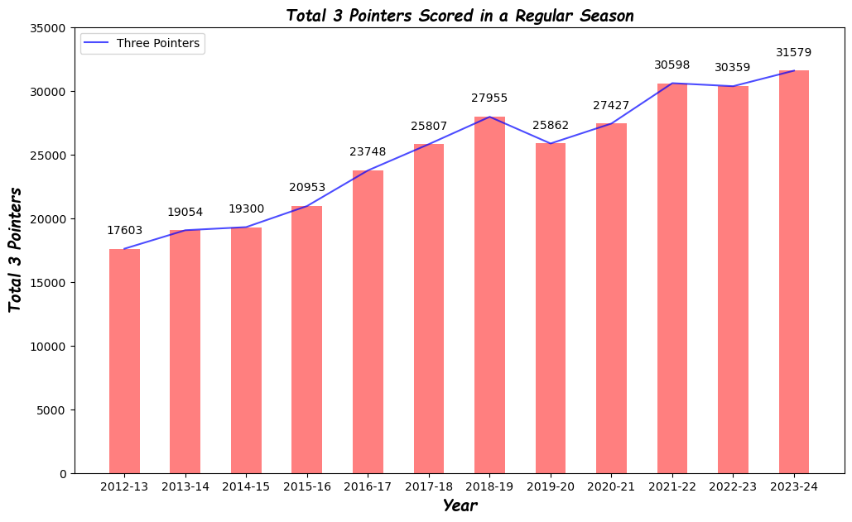
How 3 pointers in both season types over years 2012-2024 changed the scoring trends of NBA?
Regular Season
From this graph, we see an upwards trend when we analyse the total three pointers scored across 2012-2024
Which shows us that in recent years, there has been increasing emphasis on scoring Three Pointers.

Slide 12
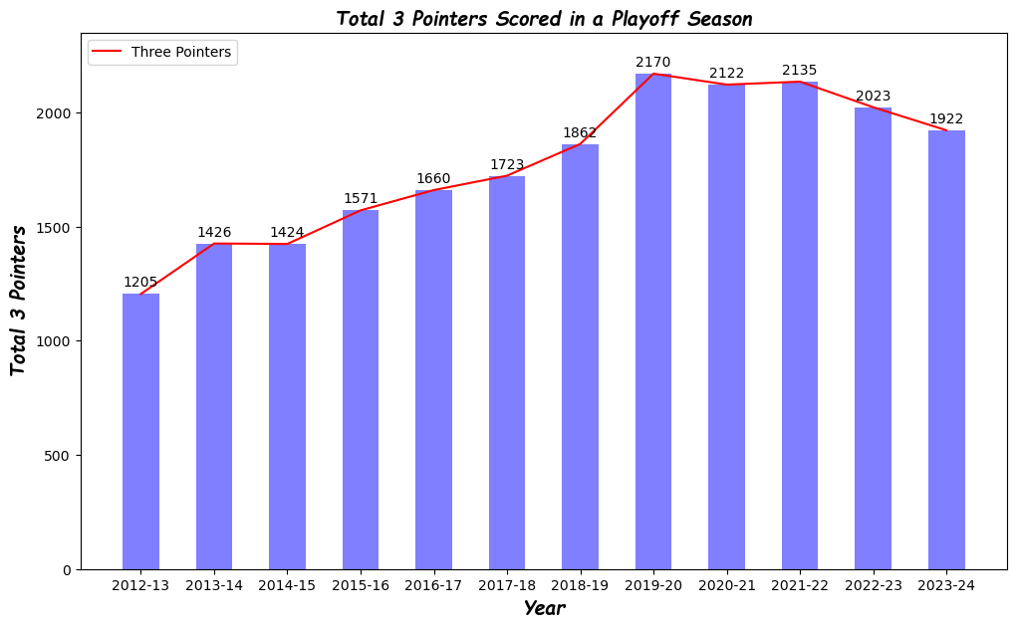
How 3 pointers in both season types over years 2012-2024 changed the scoring trends of NBA?
Playoff Season
Similarly in Playoffs as well, we see an upwards trend for scoring three pointers.
This helps us in analysing how the scoring trends have changed in the past 12 years and how three pointers are influencing strategies and game plans of all the teams.

Slide 13
Conclusion/Limitations
Conclusion:
The comparative analysis of points scored by NBA teams during the regular season and playoffs reveals important insights into team performance, consistency, and adaptability under varying conditions.
Consistency, Adaptability, Pressure Handling are some of the factors that show up when metrics like points are considered to analyze a team’s performance
Limitations:
Sample Size: The regular season typically consists of 82 games, while the playoffs involve a smaller number of games. This difference in sample size can lead to overgeneralization, as playoff data may not be as robust or representative.
The difference in variations in competition level, and changes in team dynamics due to injuries or other factors must be considered when interpreting the results.

Slide 14
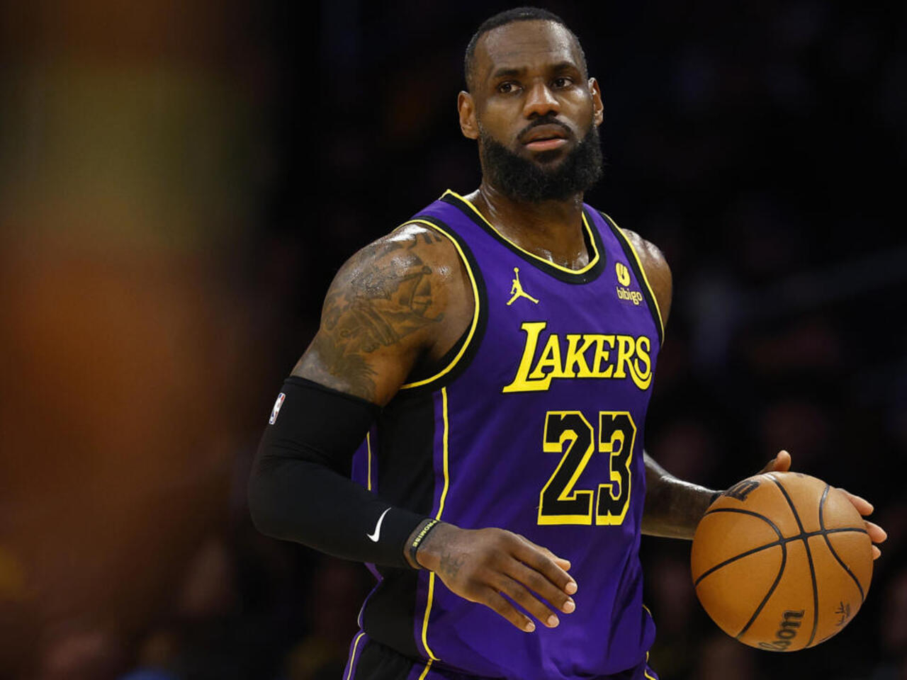
Who is the GOAT of the Game?
We've all had those lively discussions with friends who debate with us on who is the GOAT of the game. Well no more throwing darts in the dark. We as Data Analysts we base our conclusions on solid statistics and comprehensive analysis.
Based on the last 12 years, LeBron James stands out as the best performer in both the regular seasons and playoffs season. But our work does not stop here, coming next is the analysis from MJ era, so that we can conclude on who is the actual GOAT of the two.

Slide 15

QUESTIONS?

